Slide 1
Bloom’s Taxonomy

Slide 2

What is it???
Bloom’s Taxonomy is a chart of ideas
  A Taxonomy is an arrangement of ideas
    or a way to group things together
Named after the creator, Benjamin Bloom

Slide 3
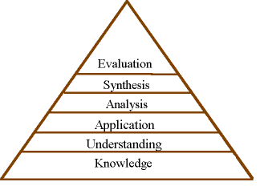
Bloom’s Taxonomy
You may see the levels organized differently in other charts

Slide 4
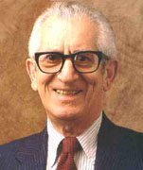
Who is Dr. Benjamin Bloom??
He was a teacher, thinker, & inventor
He worked at a college
He created a list about how we think about thinking… you may want to read that again!
1913-1999

Slide 5






The levels of thinking
There are six levels of learning according to Dr. Bloom
The levels build on one another. The six levels all have to do with thinking.
Level one is the lowest level of thinking of thinking
Level six is the highest level of thinking
Knowledge
Comprehension
Application
Analysis
Synthesis
Evaluation

Slide 6
New names??
Some people have renamed these levels to make them easier to remember
Some people even switch the last two levels around
Knowledge- Remembering
Comprehension- Understanding
Application- Applying
Analysis- Analyzing
Synthesis- Creating
Evaluation- Evaluation

Slide 7

Knowledge or Remembering
observation and recall of information
knowledge of dates, events, places
knowledge of major ideas
mastery of subject matter
Key words:
list, define, tell, describe, identify, show, label, collect, examine, tabulate, quote, name, who, when, where, etc.

Slide 8
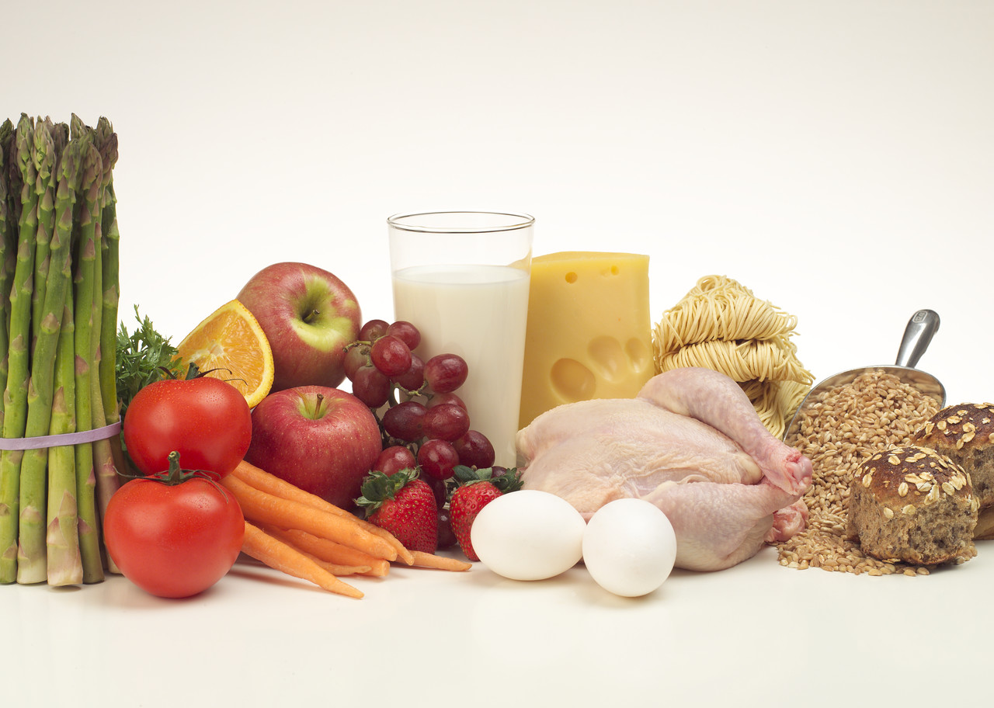
Knowledge/Remembering- Do it…
Write a list of vegetables.

Slide 9
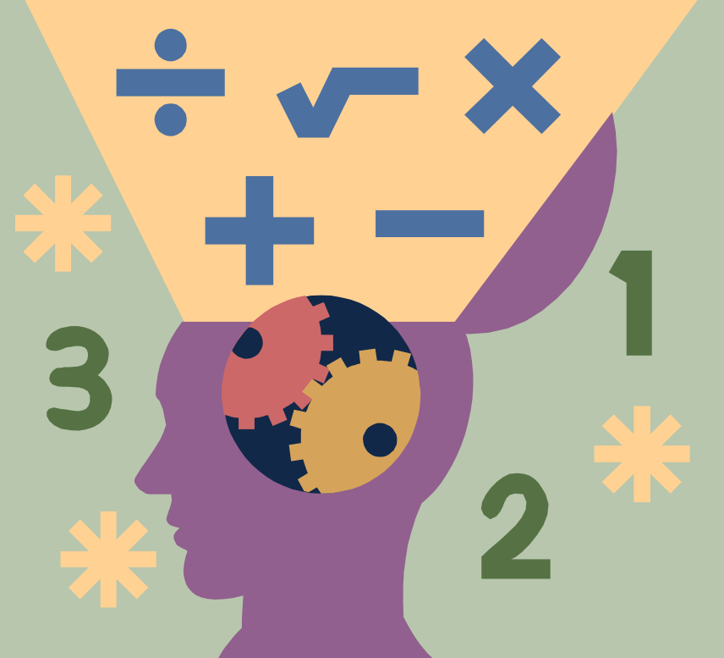
Comprehension or Understanding
understanding information
grasp meaning
translate knowledge into new context
interpret facts, compare, contrast
order, group, infer causes
predict consequences
Key words:
summarize, describe, interpret, contrast, predict, associate, distinguish, estimate, differentiate, discuss, extend

Slide 10
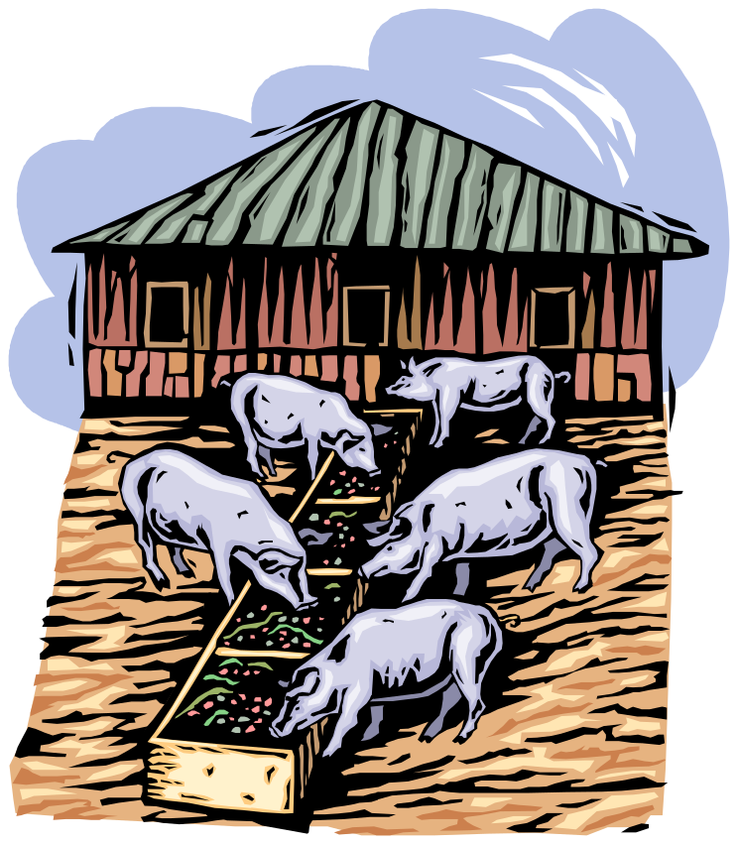
Comprehension/ Understanding- Do it…
Retell the story of the “Three Little Pigs” in your own words.

Slide 11

Application or Applying
use information
use methods, concepts, theories in new situations
solve problems using required skills or knowledge
Key words:
apply, demonstrate, calculate, complete, illustrate, show, solve, examine, modify, relate, change, classify, experiment, discover

Slide 12

Application/Applying- Do it…
Make a model of a swing set with paper and explain how it works.

Slide 13

Analysis or Analyzing
seeing patterns
organization of parts
recognition of hidden meanings
identification of components
Key words:
analyze, separate, order, explain, connect, classify, arrange, divide, compare, select, explain, infer

Slide 14

Analysis/ Analyzing- Do it…
Make a family tree showing relationships.

Slide 15
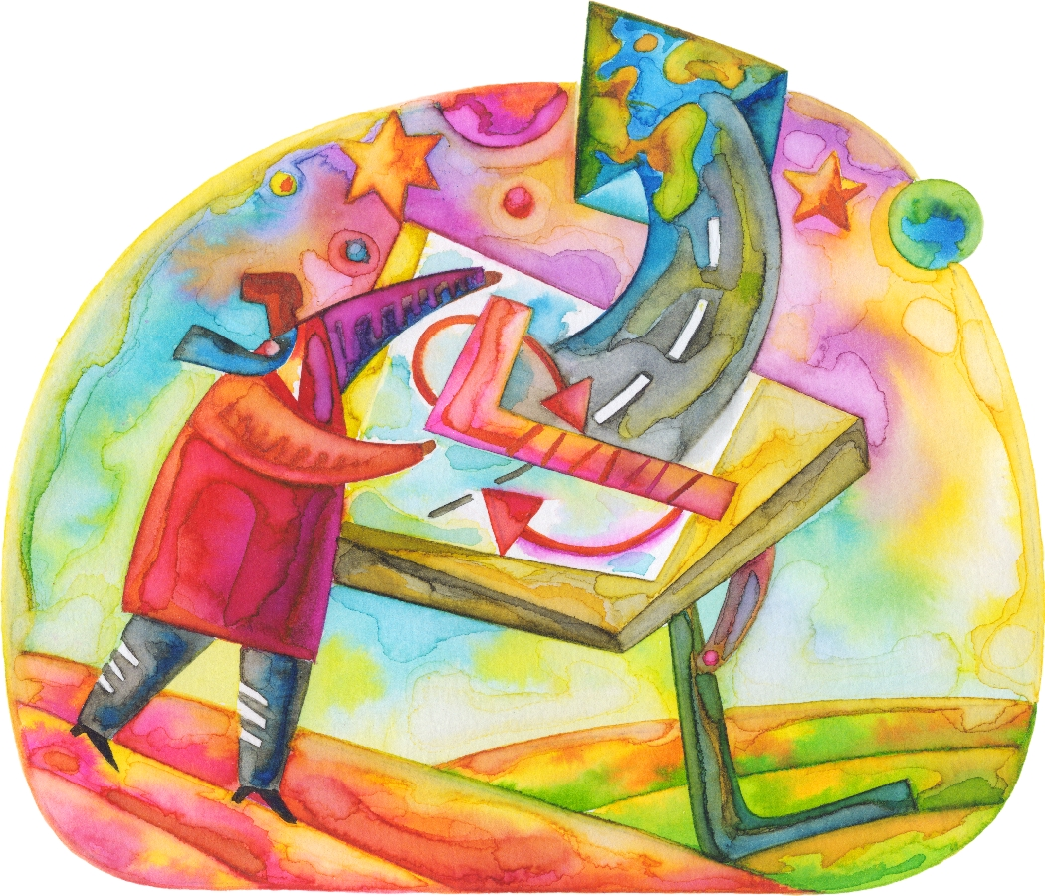
Synthesis or Creating
use old ideas to create new ones
generalize from given facts
relate knowledge from several areas
predict, draw conclusions
Key words:
combine, integrate, modify, rearrange, substitute, plan, create, design, invent, what if?, compose, formulate, prepare, generalize, rewrite

Slide 16

Synthesis/Creating- Do it…
Design a magazine cover that would appeal to kids in your class.

Slide 17

Evaluation or Evaluating
compare and discriminate between ideas
assess value of theories, presentations
make choices based on reasoned argument
verify value of evidence
recognize subjectivity
Key words
assess, decide, rank, grade, test, measure, recommend, convince, select, judge, explain, discriminate, support, conclude, compare, summarize

Slide 18

Evaluation/Evaluating- Do it…
Make a booklet about 5 rules you see as important. Convince others.

Slide 19

Bloom’s Taxonomy and Research
When doing research you should always start with the lower levels of thinking
  You must have basic knowledge before you can advance to deeper ideas
  One great way to improve your knowledge is to READ, READ, READ about your research topic
When doing research, always be sure to stretch your thinking to the higher levels of thinking
  After you’ve explored your basic knowledge base, challenge your self to new ideas
  Always keep a Bloom’s Taxonomy “cheat” sheet with you to help you hit the higher levels of thinking

Slide 20

Bloom’s Taxonomy- Do it…
Print out the next slide. This is a kid’s friendly copy of Bloom’s Taxonomy and put it in your research folder for quick reference.

Slide 21




Analysing
Breaking information into parts to explore understandings and relationships
Comparing, organising, deconstructing, interrogating, finding
Remembering
Recalling information
Recognising, listing, describing, retrieving, naming, finding
BLOOM’S REVISED TAXONOMY
Understanding
Explaining ideas or concepts
Interpreting, summarising, paraphrasing, classifying, explaining
Creating
Generating new ideas, products, or ways of viewing things
Designing, constructing, planning, producing, inventing.
Evaluating
Justifying a decision or course of action
Checking, hypothesising, critiquing, experimenting, judging
Applying
Using information in another familiar situation
Implementing, carrying out, using, executing
Source: http://www.kurwongbss.eq.edu.au/thinking/Bloom/BLOOM%20(one%20page%20poster).doc

Slide 22
Sources
http://www.coun.uvic.ca/learn/program/hndouts/bloom.html
http://www.teachers.ash.org.au/researchskills/dalton.htm
http://oaks.nvg.org/taxonomy-bloom.html
http://en.wikipedia.org/wiki/Image:Bloom%27s_Rose.png

